Slide 1
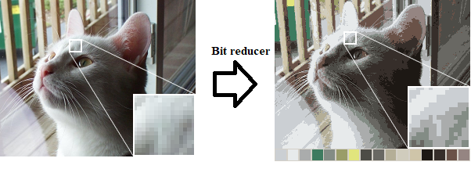
Reconfigurable Hardware Color Depth Changer
Daniel Heer, Timothy Kidd, David Bui, Reinhart Paghunie, Aaron Nguyen
Professor Mohammad El-Hadedy

Slide 2
Introduction (Color Depth)
The image’s color information represented in bits (bit depth).
The higher the amount of bits, the more detailed the image becomes.
Each image’s color is defined by a red, green, and blue color map.

Slide 3
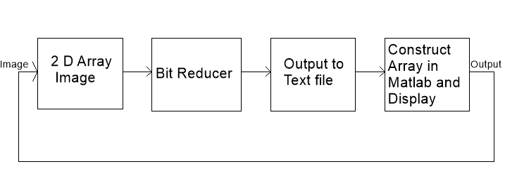
What our plan is

Slide 4
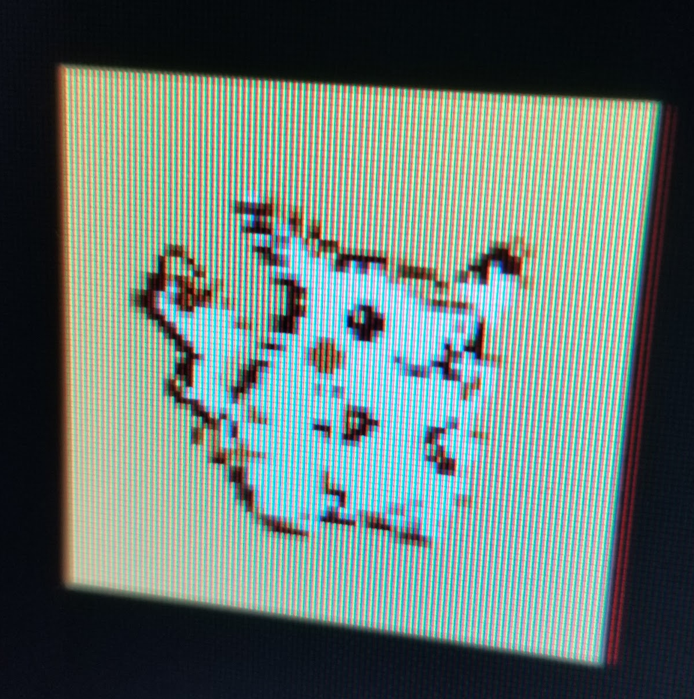
Limitations
Context is off, we are trying to implement one part of an encoder with no working encoder to test on
Displaying to VGA was more problematic than expected
Attempted pixel index with color map method
Was not able to display large images
Unable to identify where the distortions are coming from
Assuming VGA, the largest color range we could have used was 4 bit per red, green, blue

Slide 5
Store image on hardware
MATLAB reads an image and converts image into an array of binary numbers to be stored in a text file.
Input of system is the binary RGB values of the text image.
Generic 2-dimensional array created to store each slot of data.
Counter made using if else statements to iterate through the array slots.

Slide 6
Color Depth Reduction
Receives a specified size input and reduces it to a smaller specified size output
Split the input into the R,G,B color channels
The reduction happens by dividing the color channels by a power of 2 and taking the least significant bits
Skip the division by taking the most significant bits instead
Concatenate and output the reduced color channels

Slide 7
Simulation
Takes red, green, and blue channel text files as inputs, concatenates them and feeds them into the bit reducer
Outputs the bit reduced versions of red, green, and blue channels into corresponding text files
Substitutes inputting an image through onboard means and partially substitutes displaying the output

Slide 8
Array Reconstruction in Matlab
As a proof of concept for VGA we decided to simulate the displaying of it in Matlab
We went from 8 bit color depth to 4 bit color depth, but Matlab’s image show functions only read unsigned integers 8 bits and above.
So we have to cast them to unsigned 8 bit integers and load them in from the text files from simulation.
After this the values are representative of 4 bit color depth which is really close to black when Matlab interprets it in 8 bit color depth

Slide 9
Array Value Resizing
In order to catch up to 8 bit color depth we multiply each value by 16 so that their amplitudes are representative
How we know it’s 16 is by this equation
(2^8) = 256 possible colors in 8 bit color depth for each r g and b
(2^4) = 16 possible colors in 4 bit color depth for each r g and b
256/16 = 16
This is how we chose to scale it up in order for MATLAB to display it
Otherwise if we loaded the values we had from our hardware into a vga driver it would display it properly
This is because our board only has 4 bits for r g and b

Slide 10
Possible Applications
Save space in memory for devices that might need it but do not care about the color depth
Solve incompatibility issues with different display drivers

Slide 11
